Slide 1
MODULE 3 NOSQL

Slide 2
Module 3- Contents
Introduction to NoSQL, NoSQL business drivers
NoSQL data architecture patterns: Key-value stores, Graph stores, Column family (Bigtable) stores, Document stores, Variations of NoSQL architectural patterns, NoSQL Case study
NoSQL solution for big data, Understanding the types of big data problems; Analyzing big data with a shared-nothing architecture; Choosing distribution models: master-slave versus peer-to-peer; NoSQL systems to handle big data problems.

Slide 3
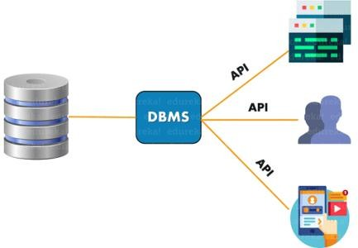
DBMS
DBMS or Database Management System is a software application used to access, create, and manage databases.
A DBMS consists of a group of commands to manipulate the database and acts as an interface between the end- users and the database.

Slide 4
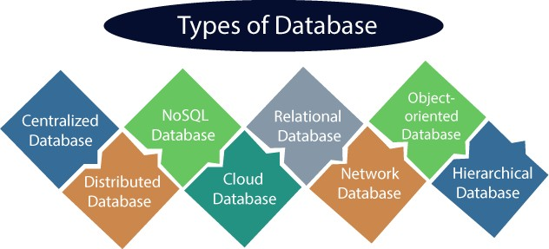

Slide 5
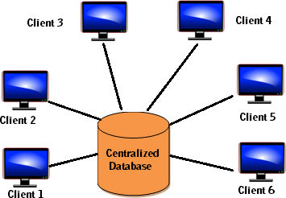
Centralized Database
It is the type of database that stores data at a centralized database system.
It comforts the users to access the stored data from different locations through several applications.
These applications contain the authentication process to let users access data securely.
An example: Central Library that carries a central database of each library in a college/university.
Not easy to update,
Response time for fetching,
Data loss in case of server failure !
MySQL
Oracle DB
MS SQL server

Slide 6
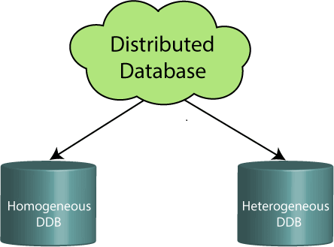
Distributed Database
Data is distributed among different database systems of an organization.
These database systems are connected via communication links. Such links help the end-users to access the data easily.
Modular development is possible in a distributed database, i.e., the system can be expanded by including new computers and connecting them to the distributed system.
One server failure will not affect the entire data set.
Examples Apache Cassandra, HBase, MongoDB ,HDFS etc.

Slide 7
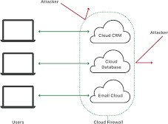
Cloud Database
A type of database where data is stored in a virtual environment and executes over the cloud computing platform.
This data is accessible over the Internet.
Cloud databases are also called a database as service (DBaaS)
It provides users with various cloud computing services (SaaS, PaaS, IaaS, etc.) for accessing the database.
There are numerous cloud platforms, but the best options are: Amazon Web Services(AWS): Amazon DynamoDB, Microsoft Azure:Azure Cosmos DB: , Oracle database cloud services, Google Cloud SQL, etc.

Slide 8
Object-oriented Databases
The type of database that uses the object-based data model approach for storing data in the database system.
The data is represented and stored as objects which are similar to the objects used in the object-oriented programming language.
Objects are the real-world entity, and types are the collection of objects.
It is an alternative implementation to that of the relational model.
properties: Objects, Classes, Inheritance, Polymorphism, Encapsulation:ObjectDB

Slide 9
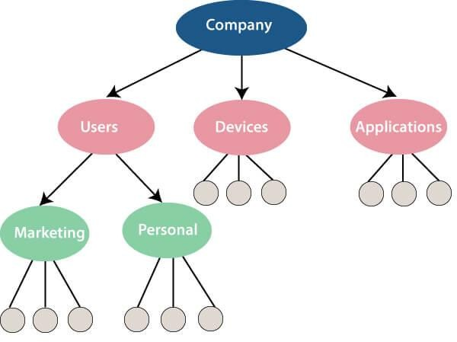
Hierarchical Databases
It is the type of database that stores data in the form of parent- children relationship nodes.
Here, it organizes data in a tree- like structure.
Data gets stored in the form of records that are connected via links.
Each child record in the tree will contain only one parent. On the other hand, each parent record can have multiple child records.
IBM Information Management System (IMS),RDM Mobile

Slide 10
Network Databases
It is the database that typically follows the network data model.
Here, the representation of data is in the form of nodes connected via links between them.
Unlike the hierarchical database, it allows each record to have multiple children and parent nodes to form a generalized graph structure.
TurboIMAGE by Hewlett-Packard (HP)

Slide 11
Personal Database: Collecting and storing data on the user's system defines a Personal Database. This database is basically designed for a single user.
Operational Database: The type of database which creates and updates the database in real-time. It is basically designed for executing and handling the daily data operations in several businesses. For example, An organization uses operational databases for managing per day transactions.
Enterprise Database: Large organizations or enterprises use this database for managing a massive amount of data. It helps organizations to increase and improve their efficiency. Such a database allows simultaneous access to users.

Slide 12
SQL
SQL stands for Structured Query Language.
It is used for storing and managing data in relational database management system (RDBMS).
It is a standard language for Relational Database System. It enables a user to create, read, update and delete relational databases and tables.
All the RDBMS like MySQL, Informix, Oracle, MS Access and SQL Server use SQL as their standard database language.
SQL allows users to query the database in a number of ways, using English-like statements.

Slide 13
Relational Database
This database is based on the relational data model, which stores data in the form of rows (tuple) and columns (attributes), and together forms a table(relation).
A relational database uses SQL for storing, manipulating, as well as maintaining the data.
Each table in the database carries a key that makes the data unique from others.
Examples of Relational databases are MySQL, Microsoft SQL Server, Oracle, IBM DB2 etc.

Slide 14
Advantages of SQL
High speed: Using the SQL queries, the user can quickly and efficiently retrieve a large amount of records from a database.
No coding needed: In the standard SQL, it is very easy to manage the database system. It doesn't require a substantial amount of code to manage the database system.
SQL is a domain language used to communicate with the database. It is also used to receive answers to the complex questions in seconds.
Multiple data view: Using the SQL language, the users can make different views of the database structure.

Slide 15
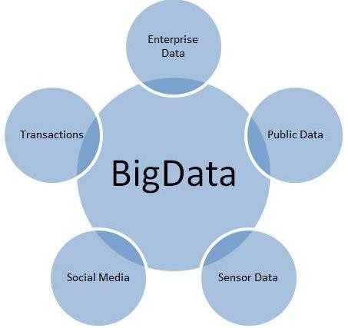
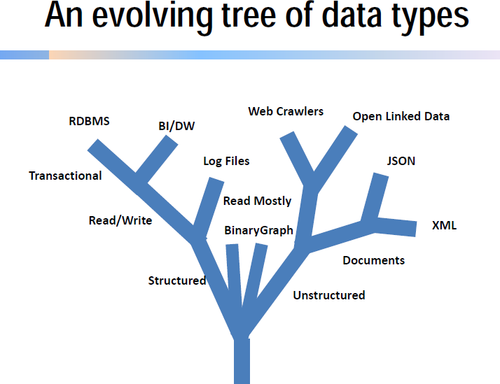
Homogeneous data storage is not possible with RDBMS, which stores data in fixed schema and big data is having variety of data.
The system response time becomes slow when you use RDBMS for massive volumes of data.

Slide 16
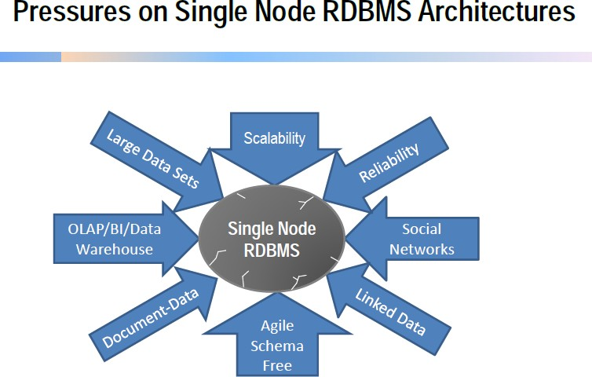

Slide 17
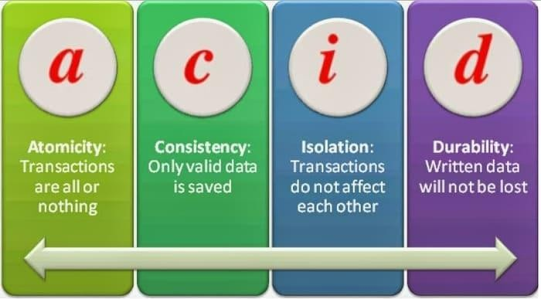
Properties of Relational Database

Slide 18
Properties of Relational Database
A means Atomicity: This ensures the data operation will complete either with success or with failure. It follows the 'all or nothing' strategy. For example, a transaction will either be committed or will abort.
C means Consistency: If we perform any operation over the data, its value before and after the operation should be preserved. For example, the account balance before and after the transaction should be correct, i.e., it should remain conserved.
I means Isolation: There can be concurrent users for accessing data at the same time from the database. Thus, isolation between the data should remain isolated. For example, when multiple transactions occur at the same time, one transaction effects should not be visible to the other transactions in the database.
D means Durability: It ensures that once it completes the operation
and commits the data, data changes should remain permanent

Slide 19
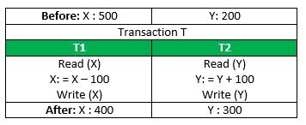
Consistency

Slide 20
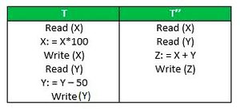
Isolation

Slide 21
What is NoSQL ?
NoSQL Database is a non-relational Data Management System, that does not require a fixed schema.
It avoids joins, and is easy to scale.
The major purpose of using a NoSQL database is for distributed data stores with homogeneous data storage needs.
NoSQL is used for Big data and real-time web apps.
For example, companies like Twitter, Facebook and Google collect terabytes of user data every single day.
NoSQL database stands for "Not Only SQL" or "Not SQL."
Carl Strozz introduced the NoSQL concept in 1998.

Slide 22
Why NoSQL ?
The concept of NoSQL databases became popular with Internet giants like Google, Facebook, Amazon, etc. who deal with huge volumes of data.
The system response time becomes slow when you use RDBMS for massive volumes of data.
To resolve this problem, we could "scale up" our systems by upgrading our existing hardware.
The alternative for this issue is to distribute database load on multiple hosts whenever the load increases. This method is known as “ scaling out”.

Slide 23
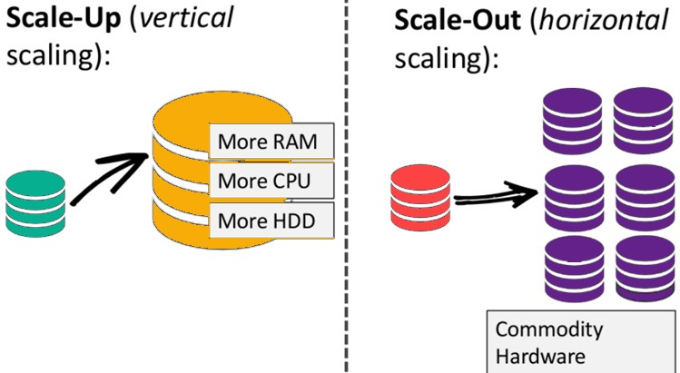
Distribute database load on multiple hosts whenever the load increases. This method is known as “Scaling out."
“Scale up" our systems by upgrading our existing hardware. This process is expensive.

Slide 24
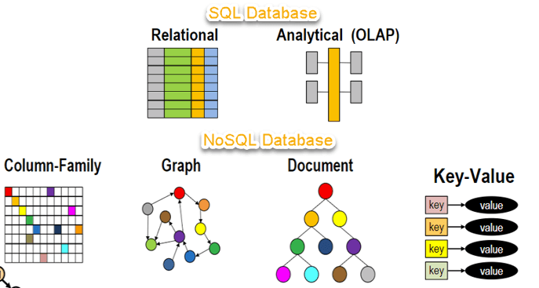

Slide 25
NoSQL Database | Relational Database
NoSQL Database supports a very simple query language. | Relational Database supports a powerful query language.
NoSQL Database has no fixed schema. | Relational Database has a fixed schema.
NoSQL Database is used to handle data coming in high velocity. | Relational Database is used to handle data coming in low velocity.
The NoSQLs data arrive from many locations. | Data in relational database arrive from one or few locations.
NoSQL database can manage structured, unstructured and semi-structured data. | Relational database manages only structured data.
NoSQL databases have no single point of failure. | Relational databases can have a single point of failure
NoSQL databases can handle big data or data in a very high volume . | NoSQL databases are used to handle moderate volume of data.

Slide 26
Brief History of NoSQL Databases
1998- Carlo Strozzi use the term NoSQL for his lightweight, open-source relational database
2000- Graph database Neo4j is launched
2004- Google BigTable is launched
2005- CouchDB is launched
2007- The research paper on Amazon Dynamo is released
2008- Facebook open sources the Cassandra project
2009- The term NoSQL was reintroduced

Slide 27
NoSQL Features
Mostly open source, Non-relational, Next Generation data base
Schema Free: Do not require sort of definition of the schema of the data, no requirement to design the tables and pushing the data to it, free from joins
Scaling : Horizontal Scaling, Implemented on commodity hardware which has separate RAM and disk
Distributed architecture and works on multiple processors to give high performance
Replication support.
Relax one or more of the ACID properties(Atomicity, Consistency,Isolation, Durability) but guarantees BASE.
No join operations
No referential integrity constraints across partitions.

Slide 28

NoSQL Business Drivers
Real Time
Velocity
Speed &
Complexity
RDBMS
Schema
Definition
Volume
Variability
Agility
Complex queries

Slide 29
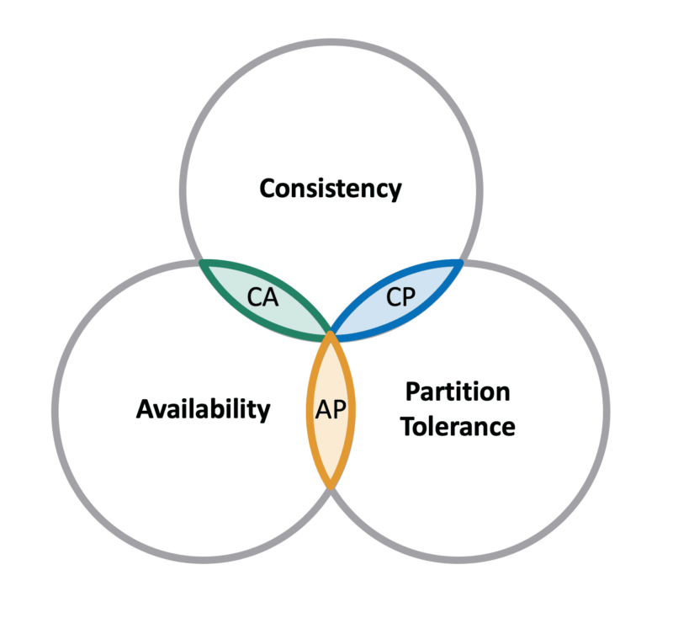
CAP Theorem(Brewer’s Theorem)
Three properties of a distributed system (sharing data)
Consistency: Guarantees all storage and their replicated nodes have the same data at the same time.
Availability: Every reads and writes are guaranteed to receive a success or failure response.
Partition-tolerance: System properties (consistency and/or availability) hold even when network failures, prevent some machines from communicating with others, (system continue to operate).

Slide 30
Brewer’s CAP Theorem
C
There is risk of some data becoming unavailable.
EX: Mongo DB, Hbase, BigTable
Network problem may stop the system Ex: RDBMS
A
P
Clients may read inconsistent data, we get back old data. Ex: Cassandra

Slide 31
Here's how the trade-offs work:
Consistency and Availability (CA): The system will be consistent and available as long as there are no network partitions. However, it may become unavailable during network partitions to maintain consistency.
Consistency and Partition Tolerance (CP): The system will remain consistent and tolerate network partitions but may sacrifice availability. This means that during a partition, some requests may be denied to maintain data consistency.
Availability and Partition Tolerance (AP): The system will be available a
nd tolerate network partitions, but it might sacrifice consistency. During a partition, different nodes might have different data, and consistency may not be guaranteed.

Slide 32
BASE Transactions
Basically Available:
There will be a response to any request.
But the response could still be failure to obtain the requested data or the data may be in an inconsistent or changing state, much like waiting for a cheque to clear in your bank account.
Basically Available indicates that the system does guarantee availability, in terms of the CAP theorem
Soft State: The state of the system could change over time, so even during times without input there may be changes going on due to eventual consistency, thus the state of the system is always soft.
Eventually Consistent :The system will eventually become consistent once it stops receiving input.

Slide 33
BASE Transactions
Eventually Consistent :
The term "eventual consistency" means to have copies of data on multiple machines to get high availability and scalability. Thus, changes made to any data item on one machine has to be propagated to other replicas.
Data replication may not be instantaneous as some copies will be updated immediately while others in due course of time. These copies may be mutually, but in due course of time, they become consistent. Hence, the name eventual consistency.

Slide 34
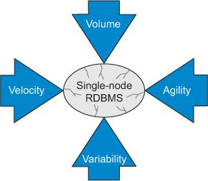
NoSQL Business Drivers: Volume
The key factor pushing organizations to look at alternatives to their current RDBMSs is a need to query big data using clusters of commodity processors.
The need to scale out (also known as horizontal scaling), rather than scale up (faster processors),
The organizations moved from serial to parallel processing where data problems are split into separate paths and sent to separate processors to divide and conquer the work.

Slide 35
NoSQL Business Drivers: Velocity
Though big data problems are a consideration for many organizations moving away from RDBMSs, the ability of a single processor system to rapidly read and write data is also key.
Many single-processor RDBMSs are unable to keep up with the demands of real-time inserts and online queries to the database made by public-facing websites like social networking sites, e-commerce websites.
When single-processor RDBMSs are used as a back end to a web store front, the random bursts in web traffic slow down response for everyone, and tuning these systems can be costly when both high read and write throughput is desired.

Slide 36
NoSQL Business Drivers: Variability
Companies that want to capture and report on certain uncommon data, struggle when attempting to use RDBMSs.
For example, if a business unit wants to store a few custom fields for a particular customer, all customer rows within the database need to store this information even though it doesn’t apply.
Adding new columns to an RDBMS requires the system be shut down and ALTER TABLE commands to be run.
When a database is large, this process can impact system availability, costing time and money.

Slide 37
NoSQL Business Drivers: Agility
The most complex part of building applications using RDBMSs is the process of putting data into and getting data out of the database.
If your data has nested and repeated subgroups of data structures, you need to include an object-relational mapping layer.
The responsibility of this layer is to generate the correct combination of INSERT, UPDATE, DELETE, and SELECT SQL statements to move object data to and from the RDBMS persistence layer.
This process isn’t simple and requires experienced developers with knowledge of object-relational frameworks

Slide 38
NoSQL data architecture patterns
Key value stores– They are the simplest NoSQL databases. Every single item in the database is stored as an attribute, name or key together with its value.
Wide column stores/ Big Tables - Wide column stores such as Cassandra and HBase are optimized for queries over large datasets, and store columns of data together, instead of rows.
Document Database– It pairs each key with a complex data structure known as document. It can contain many different key value pairs, or key array pairs or even nested documents
Graph store– They are used to store information about networks, such as social connections. Graph stores include Neo4J and Hyper Graph DB.

Slide 39
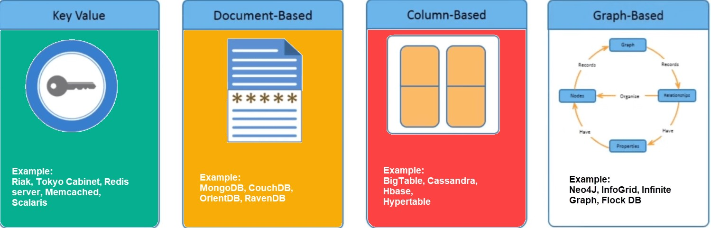
NoSQL Database Categories
Key-value: DynamoDB,Voldermort, Scalaris , Riak,Tokyo cabinet, Redis server
Column-based: BigTable, Cassandra, Hbase, Hyper Table
Document-based: MongoDB, CouchDB, Orient DB, Raven DB
Graph-based: Neo4J, InfoGrid, Infinite Graph, FlockDB

Slide 40
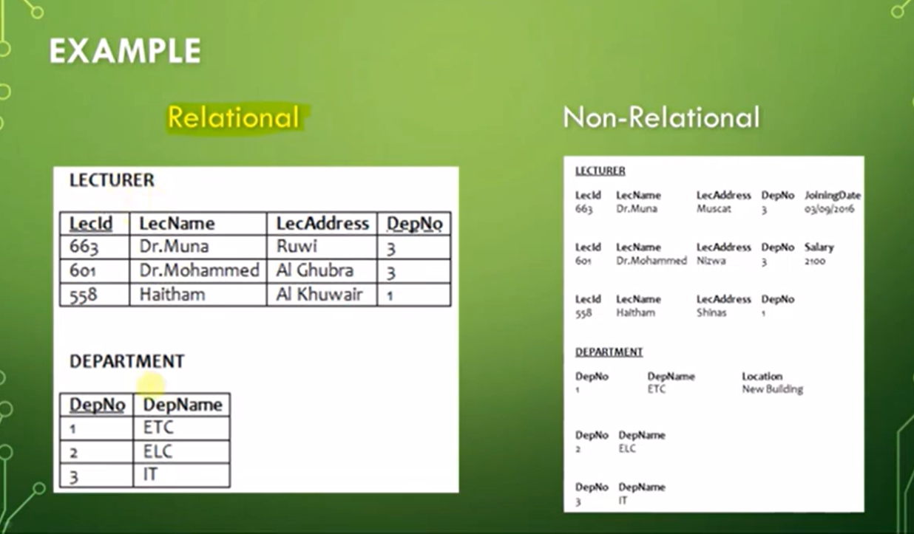

Slide 41
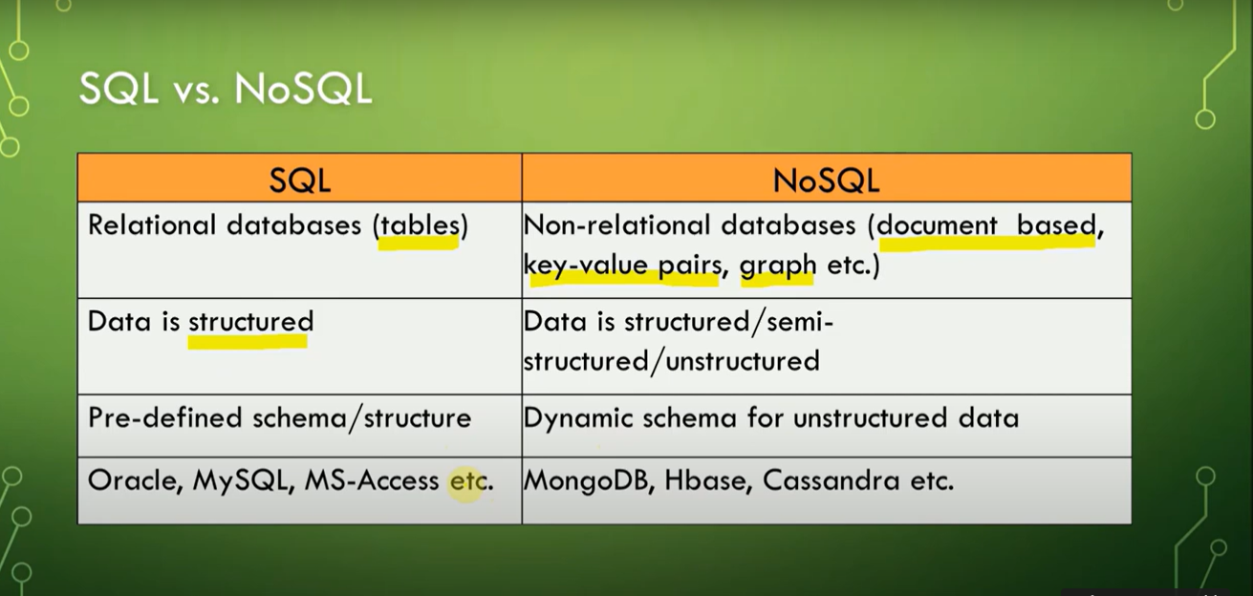

Slide 42
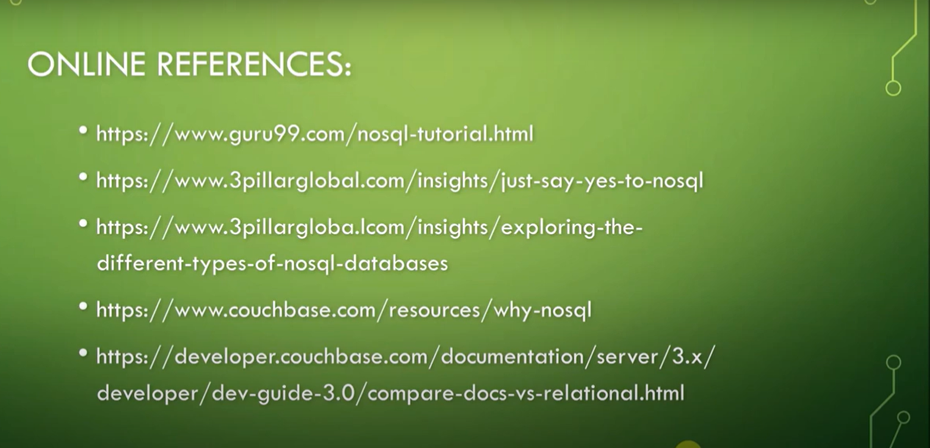

Slide 43
No Sql Learning
1 No Sql Concepts -
https://www.youtube.com/watch?v=DtCmY0JU3mM&list=PLKDJE8BkZ4wxSleTXC9m9HDpPVF9UcSh6&index=1
2 Key Value Database- https://www.youtube.com/watch?v=XroDCGGED04
3Document based Database- https://www.youtube.com/watch?v=LTTrBS5zoVc
4 Graph Database - https://www.youtube.com/watch?v=BKp7CjTlKso
5 Column store Database- https://www.youtube.com/watch?v=Z_SdLS6G7jc

Slide 44
Key Value Pair Based
Created to handle massive amounts of data and store schema-free data.
Data insertion and retrieval are simple.
Stores data as a hash table where all keys are unique and the value can be a string, JSON, BLOB (Binary Large Object) etc.
Values can be stored against strings, lists, hashes sets and sorted sets as a key.
Collections, associative arrays, and dictionaries, etc. can be used as key-value stores.

Slide 45
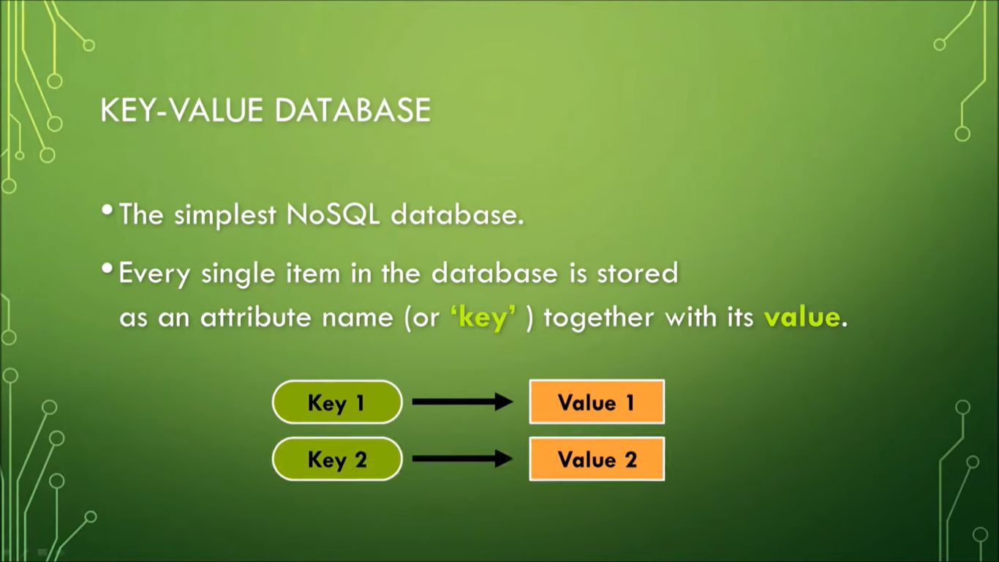

Slide 46
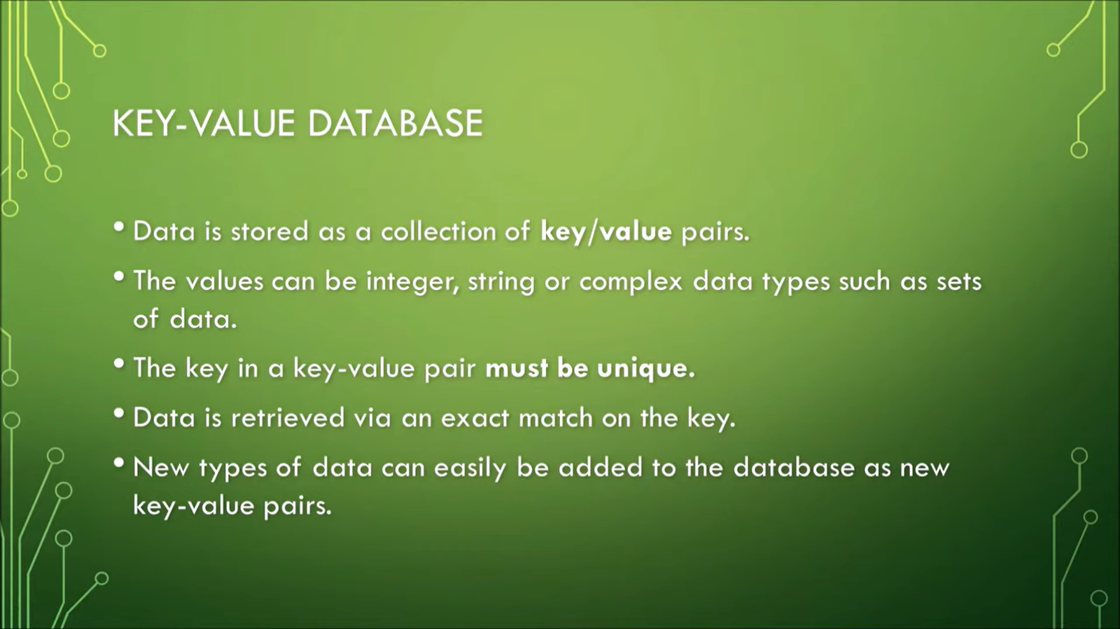

Slide 47
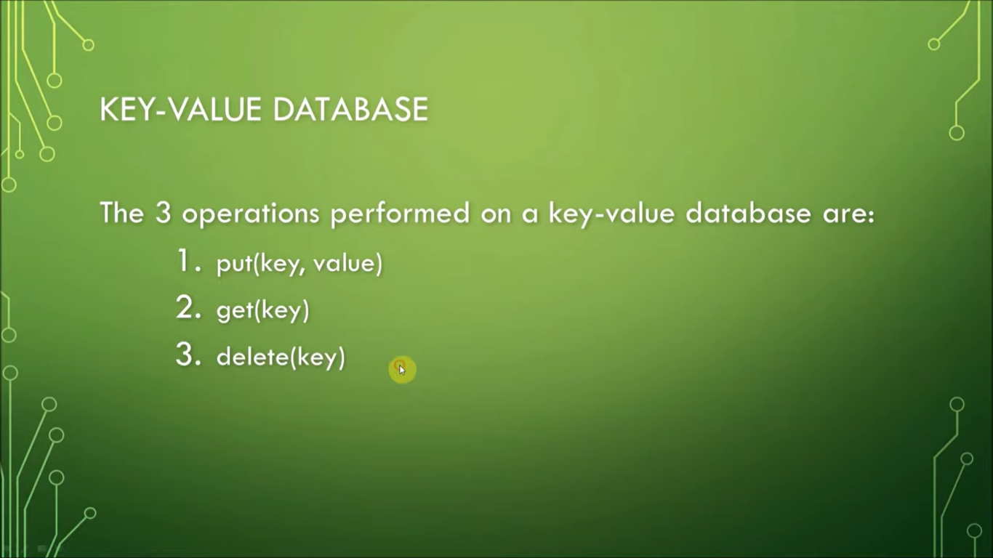

Slide 48
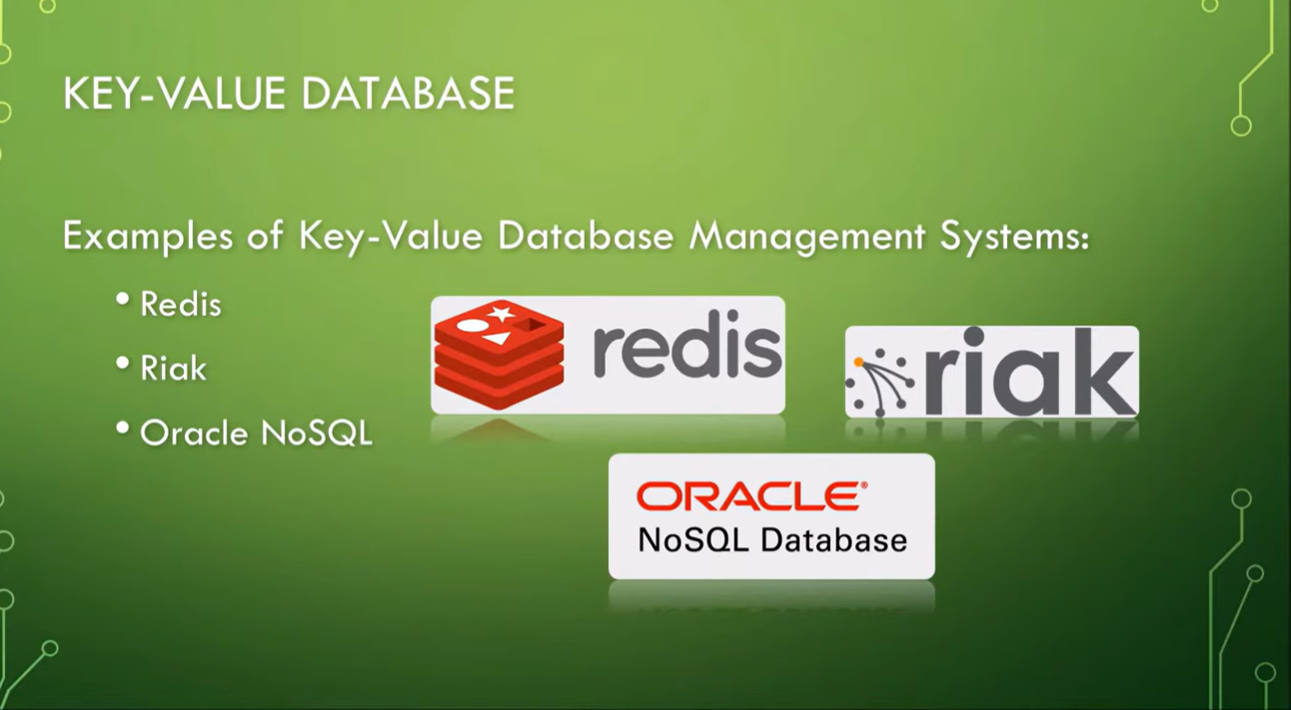

Slide 49
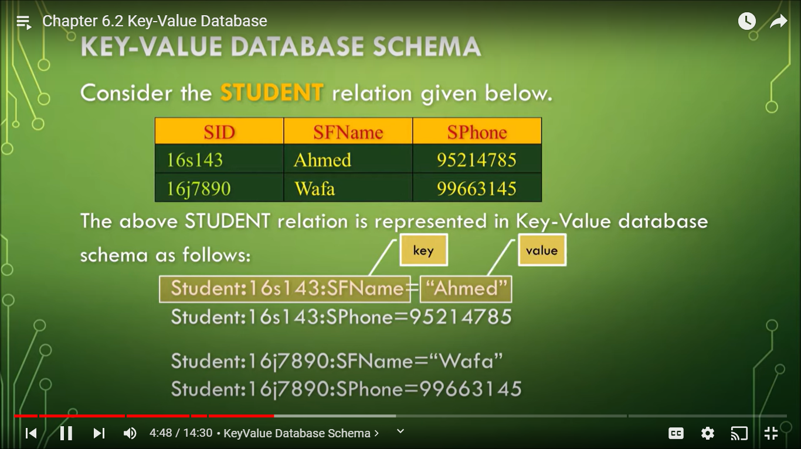

Slide 50
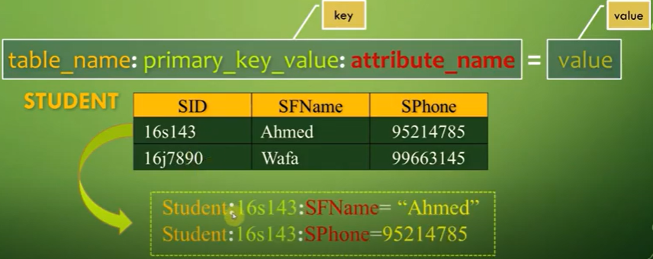
Key Value Pair Based

Slide 51
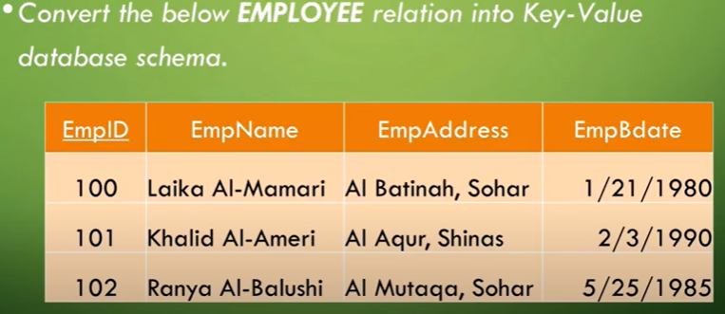
Key Value Pair Based

Slide 52
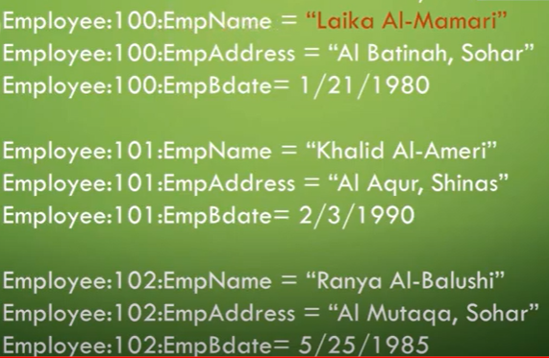
Key Value Pair Based

Slide 53
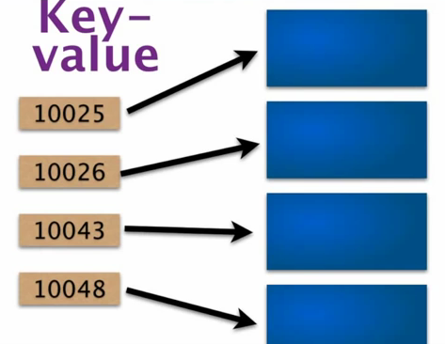
Key Value Pair Based
Uses a hash table with a unique key and pointer to a particular item of data.

Slide 54
Key Value Pair Based
Basic API access:
get(key): extract the value given a key
put(key, value): create or update the value given its key
delete(key): remove the key and its associated value
execute(key, operation, parameters): invoke an operation to the value (given its key) which is a special data structure (e.g. List, Set, Map .... etc)

Slide 55
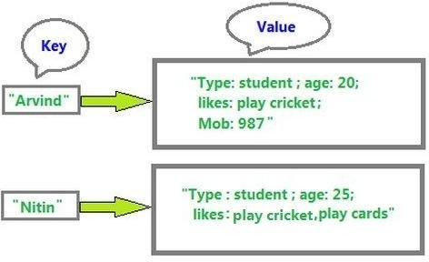
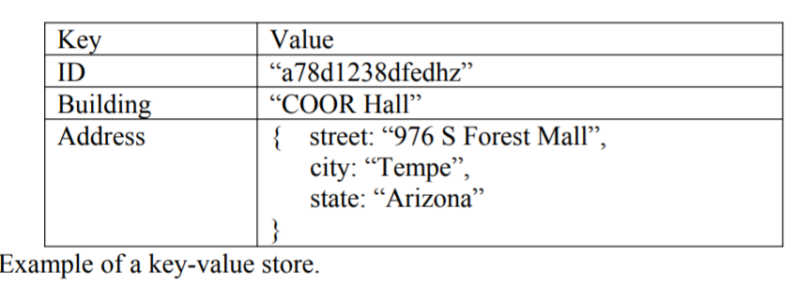
EX: Key Value Pair based
The address key is associated with a JSON value that contains three attributes: street, city, and state.
In a relational database, such a store would be invalid.

Slide 56
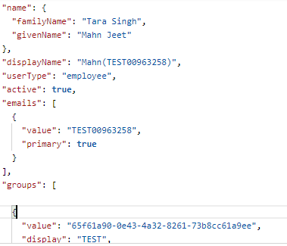

Slide 57
What can a Key-Value Database be used for?
Session store
Session data may include user profile information, messages, personalized data and themes, recommendations, targeted promotions, and discounts. Each user session has a unique identifier
Shopping cart
During the holiday shopping season, an e-commerce website may receive billions of orders in seconds. Key-value databases can handle the scaling of large amounts of data and extremely high volumes of state changes while servicing millions of simultaneous users through distributed processing and storage

Slide 58
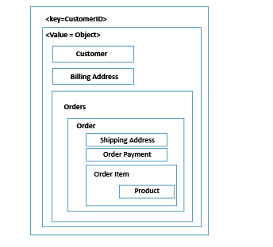

Slide 59
This JSON structure could represent a user's profile and associated data in a Snapchat-like application.

Slide 60
{
"username": "alice123",
"displayName": "Alice",
"age": 30,
"isStudent": false,
"hobbies": ["reading", "swimming"],
"address": {
"street": "123 Main St",
"city": "Wonderland"
},
"snapScore": 1500,
"friendList": ["bob456", "charlie789"],
"bitmoji": {
"hairstyle": "curly",
"outfit": "casual"
},
"story": [
{
"mediaType": "image",
"url": "https://snapchat.com/s/alice_story1",
"timestamp": "2024-08-16T14:00:00Z"
},
{
"mediaType": "video",
"url": "https://snapchat.com/s/alice_story2",
"timestamp": "2024-08-16T16:30:00Z"
}
],
"settings": {
"privacy": "friends",
"notifications": true }}

Slide 61
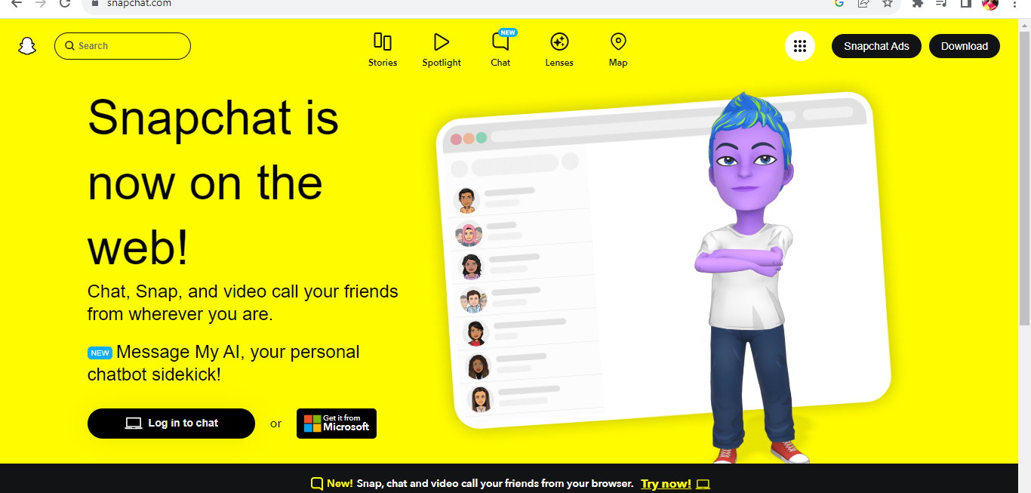

Slide 62
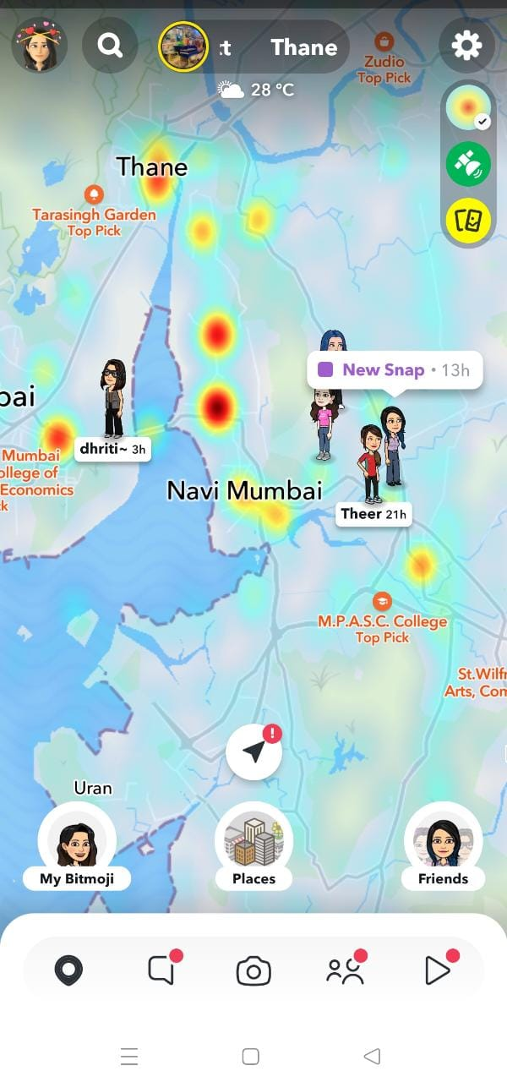

Slide 63
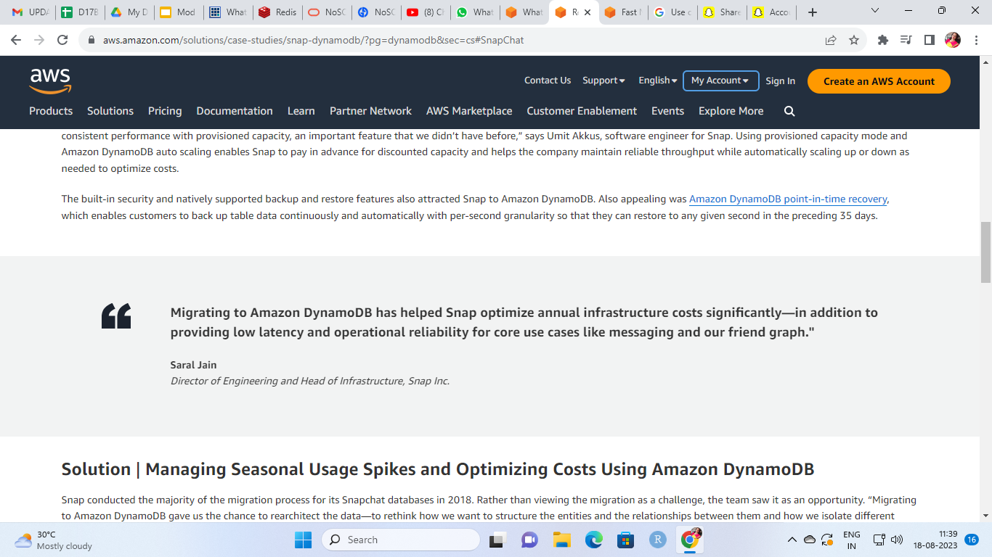

Slide 64
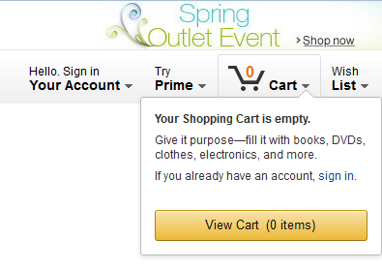
Shopping Cart Data
As we want the shopping carts to be available all the time, across browsers, machines, and sessions, all the shopping information can be put into value where the key is the userID

Slide 65



E-commerce shopping cart uses key value store
Ecommerce
Cart data
Session data
Final Order
Key value
store
Key value store
RDBMS
Amazon.com has one of the largest ecommerce operations, shopping all hours of the day all around world takes place, so the site has to be up 24*7. Developers can store unlimited amount of data by creating a data base table and saves it at multiple servers specified at the customer and also replicates at multiple available zones.The cart data and session data are stored in the key value store and final completed order is saved in RDBMs.

Slide 66
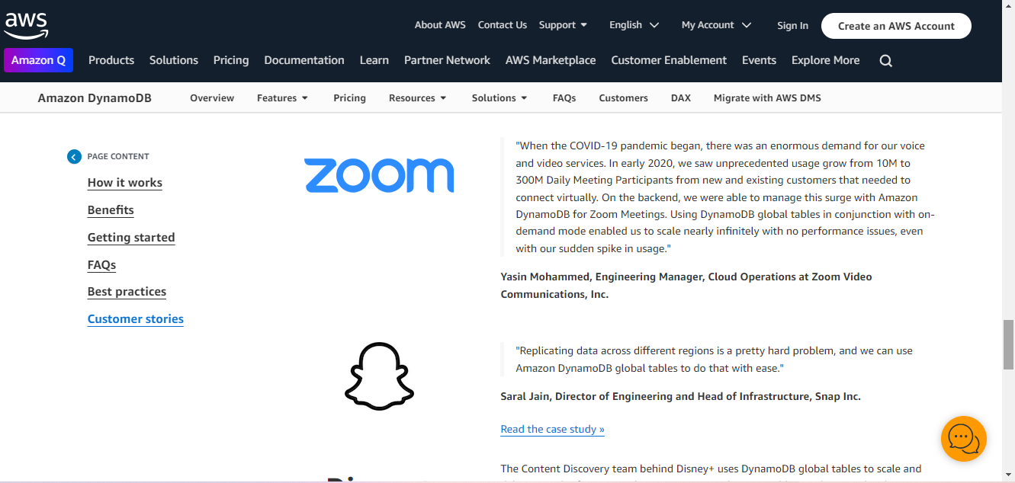

Slide 67
https://database.guide/what-is-a-key-value-database/

Slide 68
Column-based database
A column store database is a type of database that stores data using a column oriented model.
A column store database can also be referred to as a:
Column database
Column family database
Column oriented database
Wide column store database
Wide column store
Columnar database
Columnar store

Slide 69
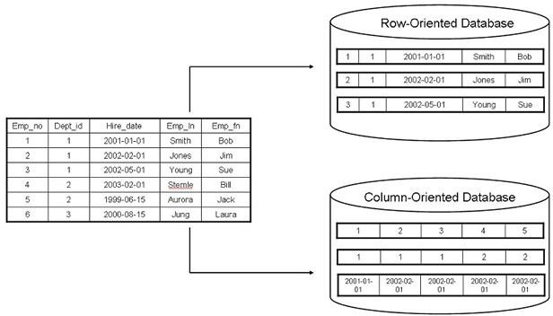
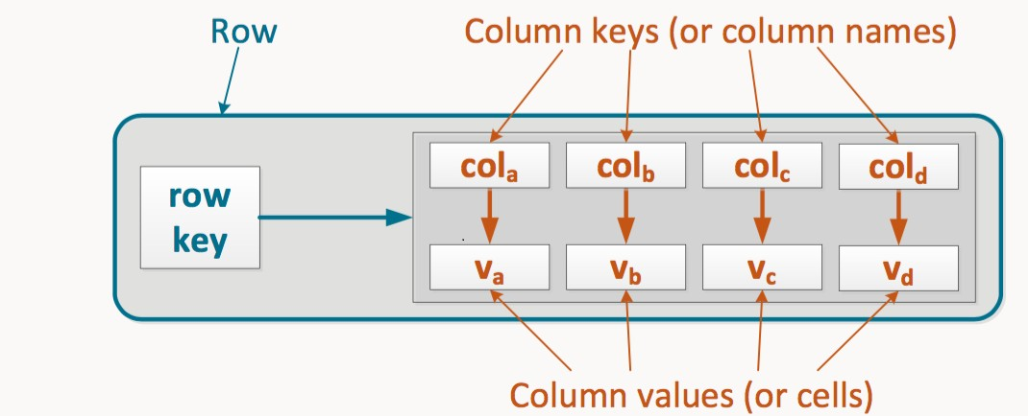

Slide 70
Every time you look something up in a row-oriented database, every row is scanned, regardless of which columns you require.
Let’s say you only want a list of birthdays in September.The database will scan the table from top to bottom and left to right, as shown in figure, eventually returning the list of birthdays.(Too much time !).
Id | Dept Id | Name | DoJ | DoB | Hobbies
1 | 1 | AAA | 11-8-2011 | 11/8/1980 | Playing
2 | 2 | BBB | 4-11-1999 | 9/5/1971 | Singing
3 | 1 | CCC | 23-8-1997 | 30/5/1971 | Cooking & Music
4 | 3 | DDD | . | . | -
5 | 3 | EEE | . | . | -
Indexing the data on certain columns can significantly improve lookup speed, but indexing every column brings extra overhead and the database is still scanning all the columns.
Hence Column Type data bases !!!

Slide 71
Column-based
Column-Oriented databases are most similar to traditional row based databases since both are usually relational.
Column-oriented databases work on columns, simply store data in columns instead of rows and are based on BigTable paper by Google(A Distributed Storage System for Structured Data)
Every column is treated separately.Values of single column databases are stored contiguously.
This allows for much faster querying and processing of data (billions of records per second, searching by column is faster)
They deliver high performance on aggregation queries like SUM, COUNT, AVG, MIN etc. as the data is readily available in a column. However inserts and updates are generally slower in column databases.

Slide 72
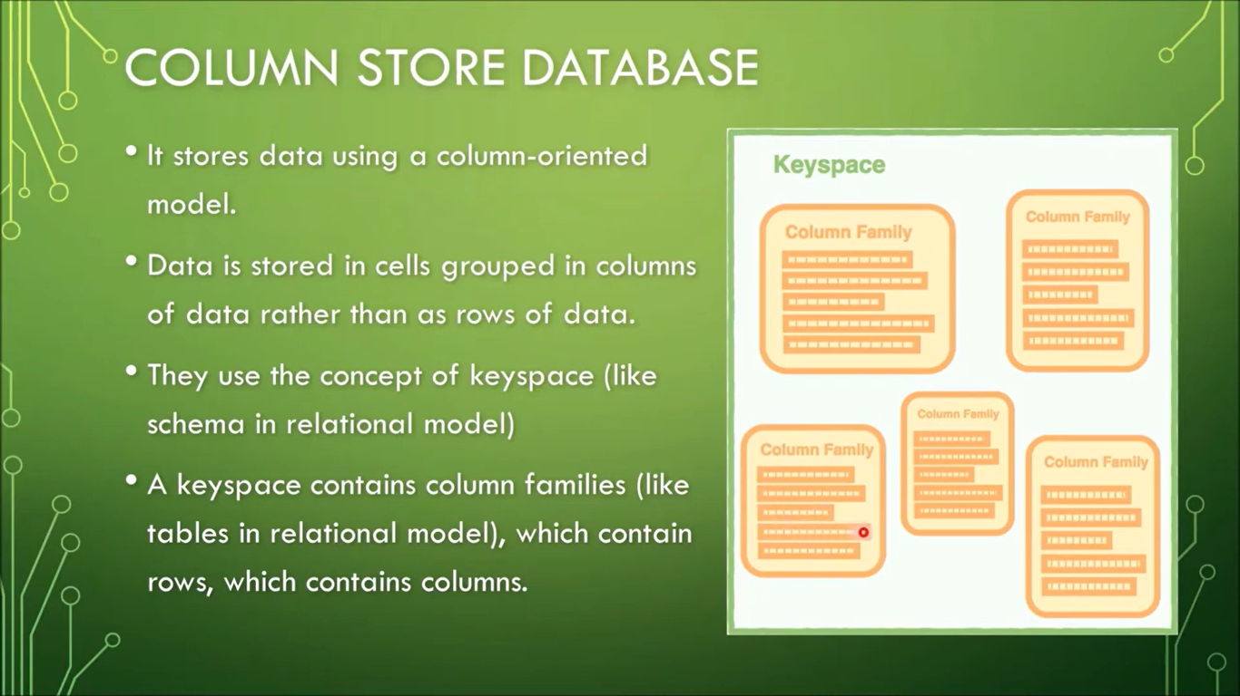

Slide 73
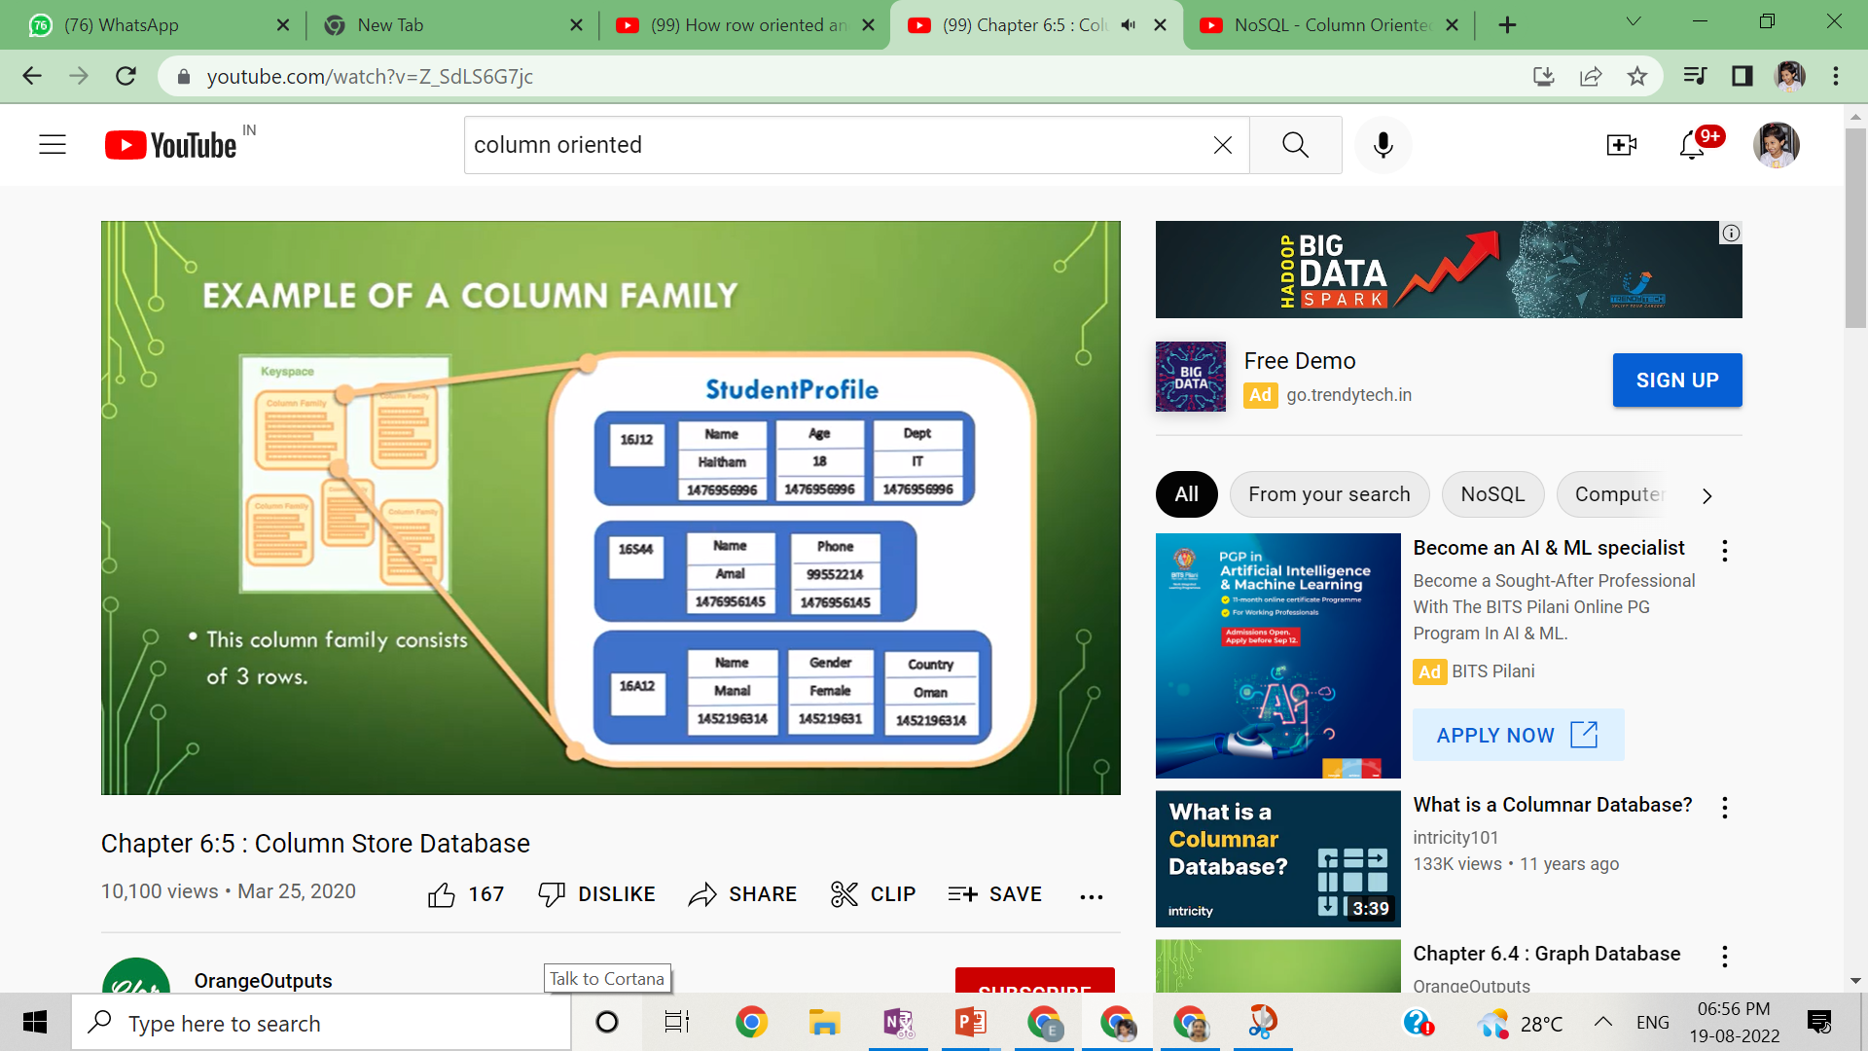

Slide 74
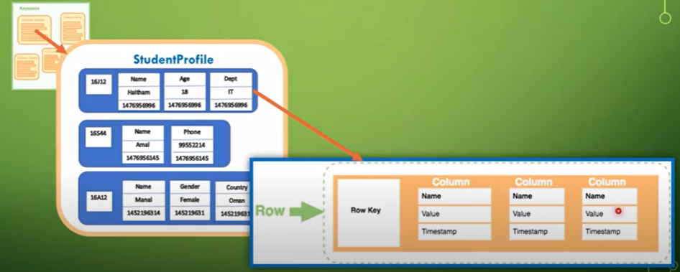

Slide 75
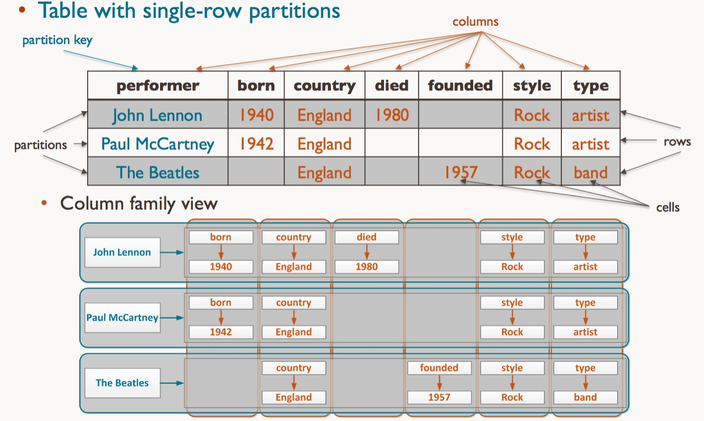
In practice, columnar databases often store data in column families. In this case you would probably not store the street, city, zip in completely separate columns, but instead in a column family where they are stored together.

Slide 76
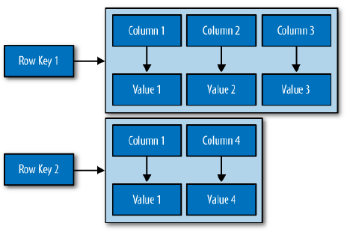
Column Family

Slide 77
#Case Studies -Google’s Bigtable—a table with a billion rows and a million columns

Slide 78
Google also influenced many software developers when they announced their Bigtable system white paper titled A Distributed Storage System for Structured Data.
The motivation behind Bigtable was the need to store results from the web crawlers that extract HTML pages, images, sounds, videos, and other media from the internet. The resulting dataset was so large that it couldn’t fit into a single relational database, so Google built their own storage system.
Their fundamental goal was to build a system that would easily scale as their data increased without forcing them to purchase expensive hardware.
The solution was neither a full relational database nor a filesystem, but what they called a “distributed storage system” that worked with structured data.
By all accounts, the Bigtable project was extremely successful. It gave Google developers a single tabular view of the data by creating one large table that stored all the data they needed.
In addition, they created a system that allowed the hardware to be located in any data center, anywhere in the world, and created an environment where developers didn’t need to worry about the physical location of the data they manipulated.

Slide 79
Case Study : Big table
BigTable, for instance is a high performance, compressed and proprietary data storage system owned by Google. It has the following attributes:
Sparse – some cells can be empty
Distributed – data is partitioned across many hosts
Multidimensional – more than 1 dimension
Map – key and value

Slide 80
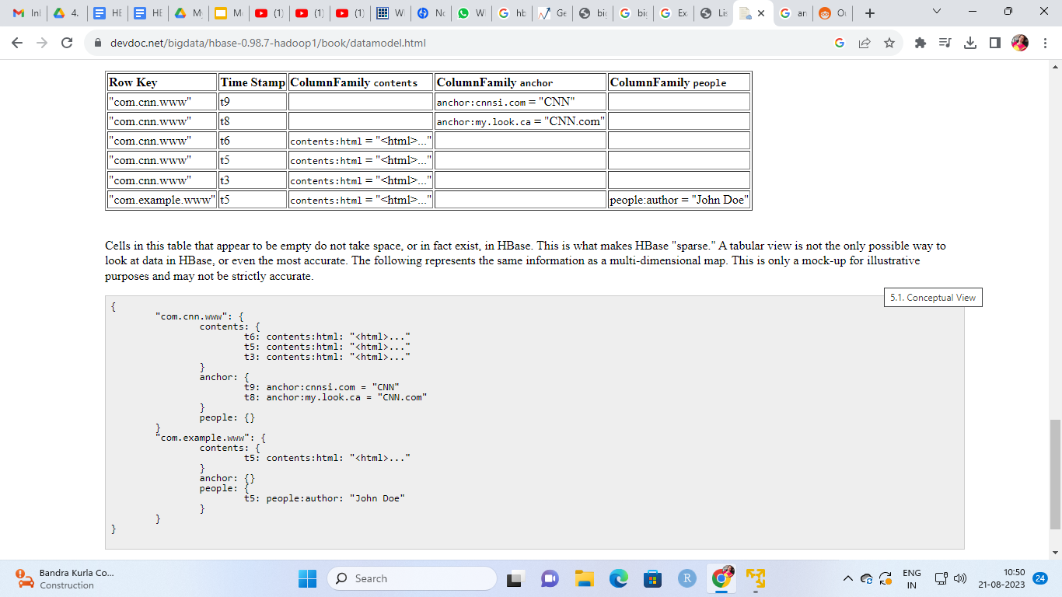

Slide 81
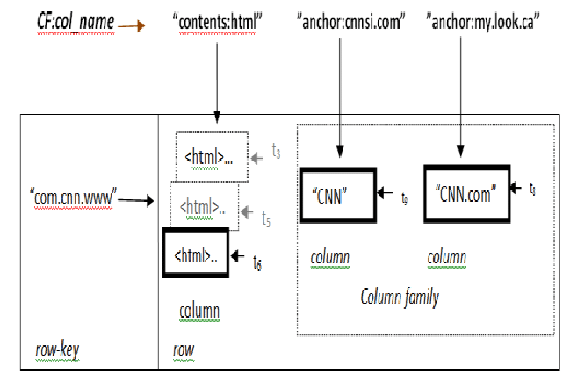

Slide 82
A slice of an example table that stores Web pages.
The row name is a reversed URL.
The contents column family contains the page contents,
and the anchor column family contains the text of any anchors that reference the page.
CNN’s home page is referenced by both the Sports Illustrated and the MY-look home pages, so the row contains columns named anchor:cnnsi.com and anchor:my.look.com

Slide 83
Examples of Column Databases
HBase,
Cassandra,
Hypertable,
Google’s big table,
Vertica,

Slide 84
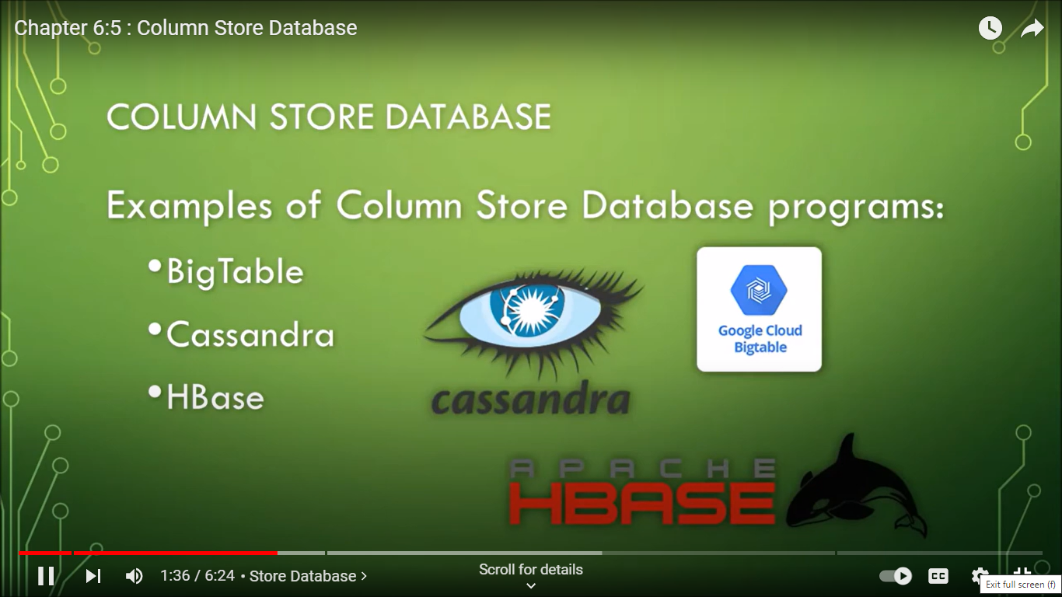

Slide 85
HBase
HBase is an open-source non-relational, scalable, distributed database written in Java.
It is developed as a part of the Hadoop ecosystem and runs on top of HDFS.
It provides random real-time read and write access to the given data.
It is possible to write NoSQL queries to get the results using APIs
Apache HBase is a NoSQL, column-oriented database that is built on top of the Hadoop ecosystem.

Slide 86
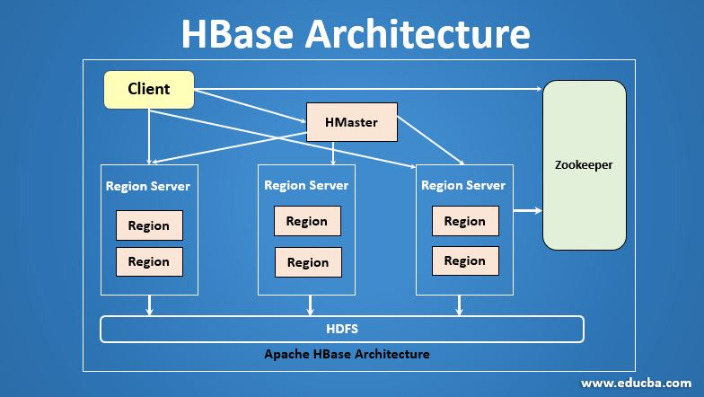

Slide 87
Use Cases
The column-oriented database gives a highly scalable architecture. and high performance as they are fast for insertion and retrieval, They have been very popular among organizations working on internet of things, big data, and personalized content recommendations.
Cassandra:
Spotify uses to store metadata about artists, songs, etc. and user profile parameters for better personalization.
HBase:
Facebook uses for various services like search indexing and the “Nearby Friends” feature.

Slide 88
Document-Oriented:
Document-Oriented NoSQL DB stores and retrieves data as a key value pair but the value part is stored as a document.
The value can can be any sort of value, array, or even another document.
The document is stored in JSON or XML formats.
They're typically schemaless, so each document can contain any data that you want them to have and you can change it on the fly.
The value is understood by the DB and can be queried.
The document type is mostly used for Content Management System, blogging platforms, real-time analytics & e-commerce applications.

Slide 89
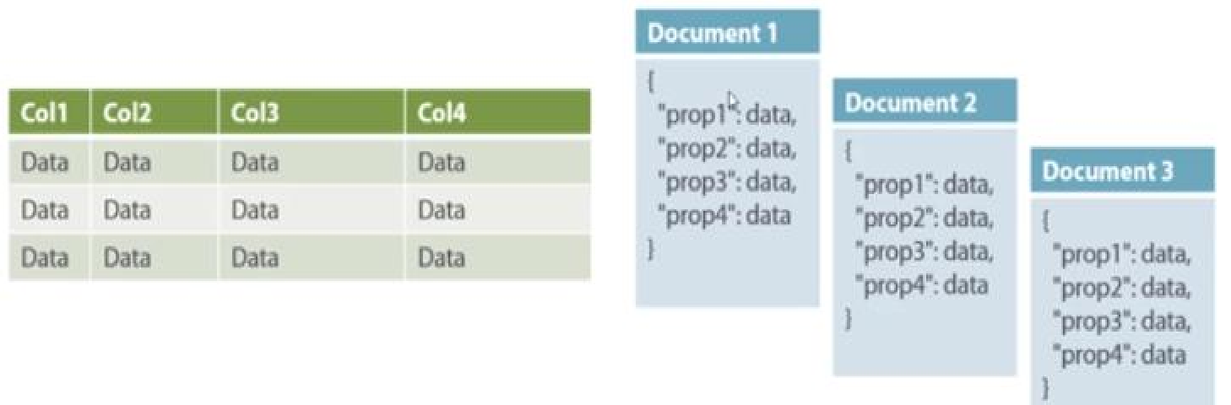
In this diagram on your left you can see we have rows and columns, and in the right, we have a document database which has a similar structure to JSON.
Now for the relational database, you have to know what columns you have and so on. However, for a document database, you have data store like JSON object.

Slide 90

-

Slide 91


Slide 92


Slide 93


Slide 94


Slide 95

Document Store vs Relational Databases

Slide 96


Slide 97


Slide 98


Slide 99
So this indicates that there are some significant differences between document store databases and relational databases.
1.Tables
Relational databases store data within multiple tables, each table containing columns, and each row represents each record. Information about any given entity could be spread out among many tables. Data from different tables can only be associated by establishing a relationship between the tables.
Document databases on the other hand, don’t use tables as such. They store all data on a given entity within a single document. Any associated data is stored inside that one document.

Slide 100
Schemas
With relational databases, you must create a schema before you load any data. With document store databases (and most other NoSQL databases), you have no such requirement. You can just go ahead and load the data without any predefined schema.
So with a document store, any two documents can contain a different structure and data type. For example, if one user chooses not to supply his date of birth, that wouldn’t even be a field within the document. If another user does supply her date of birth, that would be a field in that document. If this was a relational database, date of birth would still be a field for both users – it just wouldn’t contain a value.

Slide 101
Scalability
Document databases can scale horizontally very well. Data can be stored over many thousands of computers and the system will perform well. This is often referred to as sharding.
Relational databases are not well suited to scaling in this fashion. Relational DBs are more suited towards scaling vertically (i.e. adding more memory, storage, etc). Seeing as there’s a limit to how many resources you can fit inside one machine, there could come a point where horizontal scaling becomes the only option.

Slide 102
Relationships
Document stores don’t have foreign keys, like relational databases have. Foreign keys are used by relational databases to enforce relationships between tables. If a relationship needs to be established with a document database, it would need to be done at the application level.
However, the whole idea behind the document model is that any data associated with a record is stored within the same document. So the need to establish a relationship when using the document model should not be as prevalent as in a relational database.

Slide 103
MondoDB Data Model
A MongoDB deployment hosts a number of databases.
A database holds a set of collections.
A collection holds a set of documents.
A document is a set of key-value pairs.
RDBMS | MongoDB
Table Row(s) Index Join | Collection JSON Document Index Embedding & Linking

Slide 104
A MongoDB Document
Records in a MongoDB database are called documents, and the field values may include numbers, strings, booleans, arrays, or even nested documents.
Example Document
{
title: "Post Title 1",
body: "Body of post.",
category: "News",
likes: 1,
tags: ["news", "events"],
date: Date()
}

Slide 105


Slide 106
Document Stores
Data model: (key, document) pairs
Document: JSON, XML, other semistructured formats
Basic operations: Insert(key,document), Fetch(key), Update(key), Delete(key)
Also Fetch based on document contents
Example systems
CouchDB, MongoDB, etc

Slide 107
Suitable Use Cases
Web Analytics or Real time Analysis
User Generated Content
Chat sessions
Tweets
Blog posts
Ratings
Comments
E-commerce Applications
Catalog Data
User accounts
Product catalogs
Device registered
Billing details

Slide 108
Graph-Based
A graph database stores data in a graph.
It is capable of elegantly representing any kind of data in a highly accessible way.
A graph type database stores entities as well the relations amongst those entities.
The entity is stored as a node such as a
student or business with the relationship as edges. An edge gives a relationship between nodes.
Every node and edge has a unique identifier.
An edge always has a start node, end node, type, and direction, and an edge can describe parent-child relationships, actions, ownership, and the like.

Slide 109


Slide 110


Slide 111


Slide 112


Slide 113

Graph base model
The graph shows an example of a social network graph. Given the people (nodes) and their relationships (edges), you can find out who the "friends of friends" of a particular person are—for example, the friends of Howard's friends.

Slide 114


Slide 115


Slide 116


Slide 117


Slide 118


Slide 119


Slide 120
UseCase – For Graph Database
Any ‘Recommended for You’ rating you see on e-commerce websites (book/video renting sites) is often derived by taking into account how other users have rated the product in question.
Arriving at such a UseCase is made easy using Graph databases.

Slide 121
Case Study : Social-network graph

Slide 122

Example: Social-network graph
Each record: UserID1, UserID2
Separate records: UserID, name, age, gender etc
Task: Find all friends of friends of friends of … friends of given user

Slide 123
Comparison between the classic relational model and the graph model :
Relational model | Graph Model
Tables | Vertices and Edges set
Rows | Vertices
Columns | Key value pairs
Join | Edges

Slide 124
Use case 1
Fraud detection
Graph databases are capable of sophisticated fraud prevention. With graph databases, you can use relationships to process financial and purchase transactions in near-real time.
With fast graph queries, you are able to detect that, for example, a potential purchaser is using the same email address and credit card as included in a known fraud case.
Graph databases can also help you easily detect relationship patterns such as multiple people associated with a personal email address, or multiple people sharing the same IP address but residing in different physical addresses.

Slide 125


Slide 126


Slide 127


Slide 128


Slide 129


Slide 130


Slide 131


Slide 132


Slide 133


Slide 134


Slide 135


Slide 136


Slide 137


Slide 138


Slide 139


Slide 140


Slide 141


Slide 142


Slide 143


Slide 144


Slide 145


Slide 146


Slide 147


Slide 148


Slide 149


Slide 150


Slide 151


Slide 152


Slide 153


Slide 155


Slide 156
Use Case 2
Recommendation engines
Graph databases are a good choice for recommendation applications.
With graph databases, you can store in a graph relationships between information categories such as customer interests, friends, and purchase history.
You can use a highly available graph database to make product recommendations to a user based on which products are purchased by others who follow the same sport and have similar purchase history.
Or, you can identify people who have a friend in common but don’t yet know each other, and then make a friendship recommendation.

Slide 157


Slide 158


Slide 160





Examples of NOSQL Data Stores
Key Value Store
Redis, Amazon Dynamo DB, Azure Table Storage (ATS)
Riak, Memcached, Berkeley DB
Column Based Store
Cassandra, Google Big table, Hbase, Accumlo, Hyper Table,
Document Store
Mongo DB, Couch Base, Couch DB, Orient DB
Graph Store
Neo4j, AllegroGraph,, FlockDB

Slide 161
When to use which store ?
Key Value Store :When processing a constant stream of small reads and writes, session information, user profiles, preferences, shopping cart data
Document Types : For natural data modeling, Programmer friendly Rapid Development , content management system, blogging platform,web analytics, real time analytics, ecommerce applications
Columnar Type: For massive write loads, High availability Multiple data centres , content management systems, blogging platforms,
Graph Type : For Graph Algorithms and many to many relationships, for connected data such as social networks, recommendation engines
Select the best data store for a given data type , Use case and purpose !

Slide 162
1. Key-Value Store
Use When:
Your application requires fast lookups based on a unique key.
Data can be stored as a collection of key-value pairs, where the value can be a simple data type or a more complex structure like a JSON document.
Applications:
Session management.
User profiles or settings.

Slide 163
2. Document Store
Use When:
You need to store semi-structured data that can be represented as documents (JSON, BSON, XML, etc.).
The application requires flexibility in terms of data schema (schema-less or schema-on-read).
You need to perform complex queries on nested data.
Applications:
Content management systems (CMS).
E-commerce catalogs.
Blogging platforms.
Event logging and tracking.

Slide 164
3. Column-Family Store
Use When:
You need to handle large volumes of data across many servers.
You require quick access to a subset of columns within a large dataset.
Your application performs analytics or requires wide rows where columns can be added dynamically.
Applications:
Time-series data storage.
Real-time data processing.
Recommendation engines.

Slide 165
4. Graph Database
Use When:
Your data is highly interconnected, and relationships between data points are crucial.
You need to perform complex queries involving traversals, such as finding the shortest path, neighbors, or subgraphs.
Applications:
Social networks.
Fraud detection systems.
Recommendation engines.
Network topology mapping.

Slide 166
What is NoSQL solution for Big data
Decide the type of Data:
Only Read
Read-Write
Distributed Computing Architecture:
Shared RAM,
Shared Disk,
Shared nothing
Data Distribution Model:
Sharding : Horizontal & Vertical
Replication: Peer to peer & master
Slave
Recommendation
User Profile Management
Real Time Data Handling
Content management
Catalog management
360 Degree Customer
Review
Internet of Things
Fraud detection

Slide 167
Understand the big data problem:
Categorize the data and determine its type:
Read Read-Write
Data is read once & rarely changed
Related to warehouse applications,
item sets (Images),
event logging (clickstreams, sales events, real time sensor data:
log file records all the events along with their time stamp for each transaction,
can be an error/ warning or a normal event like a click on a web page , Users browse the website for articles, posts, view products
Documents or graph data
When write happens, master will record this change data to its binary log.The slave copies the change data from master.
Most of the times after a write operation, there is a read of the same data set.
Related to Transaction data
Making a purchase (session management)
When adding a comment
Messages on a forum

Slide 168

Distributed Computing architecture:
Each architecture works with different type of data

Slide 169
Shared RAM
In this architecture many CPUs, access a single shared RAM, over a high speed bus.
Each CPU has its own cache for faster access.
This architecture is useful for large commutations and graph store, for graph traversal entire graph should be in main memory.
Key value store and document store are cache friendly as they are indexed by a short key.

Slide 170
Shared Disk Architecture
Shared Disk Architecture is an architecture which is used in distributed computing in which the nodes share same disk devices but each node has its own private memory.
The disks have active nodes which share memory in case of any failures.
In this architecture the disks are accessible from all the cluster nodes.
This architecture has quick adaptability to the changing workloads. It uses robust optimization techniques.
Shared Disk has two advantages over Shared memory. Firstly, each processor has its own memory,the memory bus is not a bottleneck; secondly, the system offers a simple way to provide a degree of fault tolerance.

Slide 171
Shared Nothing Architecture
Shared nothing architecture is an architecture which is used in distributed computing in which each node is independent and different nodes are interconnected by a network.
Every node is made of a processor, main memory and disk.
The main motive of this architecture is to remove the contention among nodes. Here the Nodes do not share memory or storage.
The disks have individual nodes which cannot be shared.
It works effectively on high volume and read write environment.
Systems based on this architecture are also commonly known as MPP (Massively Parallel Processing) systems. In order to
achieve a good workload distribution MPP systems have to use a hash algorithm to distribute (partition) data evenly across available CPU cores.

Slide 172
Choosing Distribution Models
Aggregate oriented databases make distribution of data easier, since the distribution mechanism has to move the aggregate and not have to worry about the related data as all the related data is contained in the aggregate.
Styles : Sharding & Replication
A system may use either or both techniques
Ex: Riak database shards the data and also replicates

Slide 173
Sharding
Database sharding is the process of making partitions of data in a database or search engine, such that the data is divided into various smaller distinct chunks, or shards.
Each shard could be a table, a Postgres schema, or a different physical database held on a separate database server instance.
To shard your data, you need to decide a key, called a sharding key, to partition your data on.
The shard key is either an indexed field or indexed compound fields that exist in every document in the collection.

Slide 174

Some data within the database remains present in all shards (vertical sharding),
some data appear only in single shards (horizontal sharding).

Slide 175
Replication
Copy of data across multiple server. ( So as to make data available )
It has two forms : Master Slave & Peer to Peer replication
Master Slave Replication: One node is authorized one, who handle write operation and all slaves synchronize with the master and handle reads
Reduces conflicts during updates
Hbase uses master slave model

Slide 176

Peer to Peer Replication: This allows write to any node, the nodes coordinate between themselves to synchronise their copies of data.
All writes handling is not on a single node.
Each node takes the responsibility of master so if one node gets fail other nodes can continue to function.
All nodes have to be kept up to date with the cluster status which increases communication overhead.
Cassandra uses peer to peer model

Slide 177


Slide 178


